Slide 1
Build, operate, and observe a Serverless application on AWS
Muyahid Sassantiwong
DevOps

Slide 2
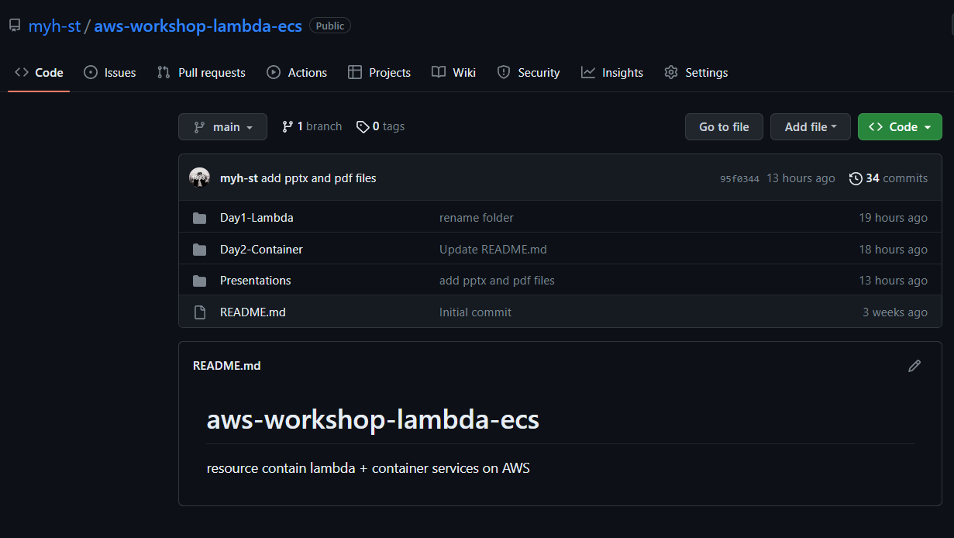
Workshop URL : myh-st/aws-workshop-lambda-ecs: resource contain lambda + container services on AWS (github.com)

Slide 3
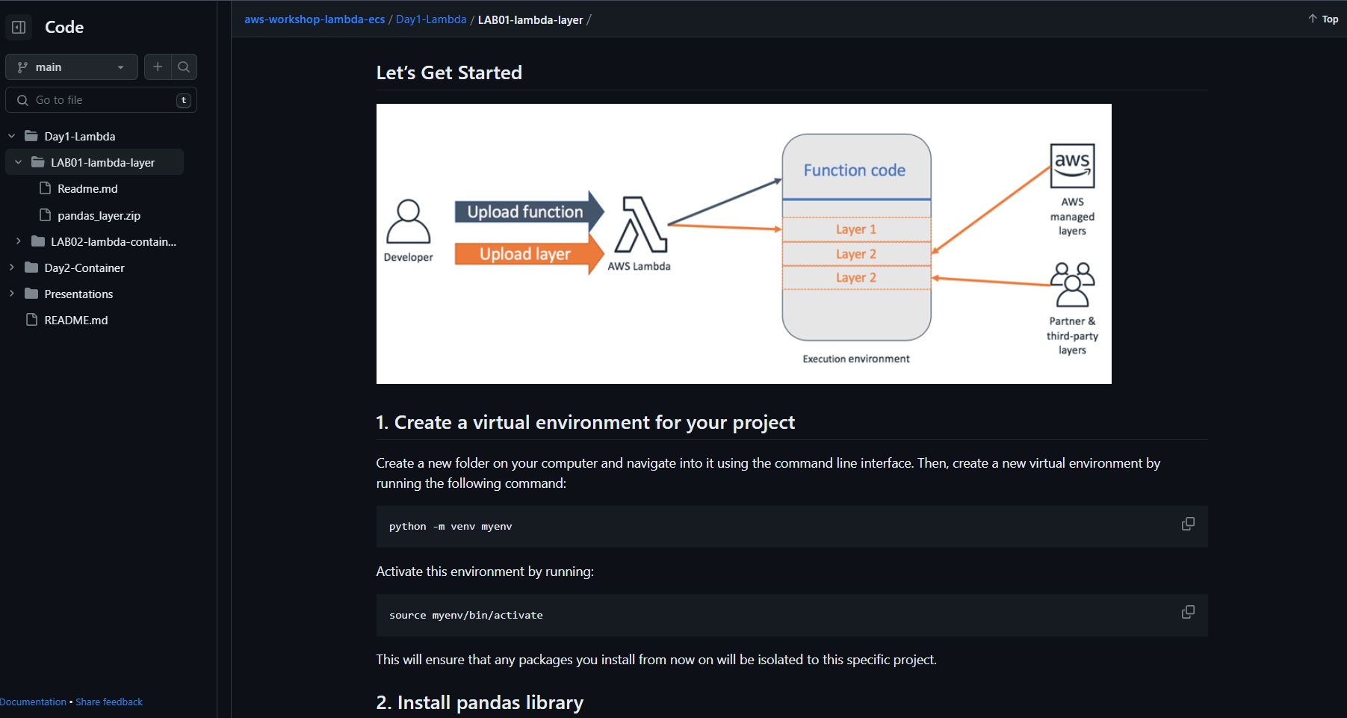

Slide 4
Learning Path
Getting Started - Cloud Computing Tutorials for Building on AWS (amazon.com)
Copilot Primer Workshop (workshops.aws)
AWS Events Content (amazon.com)
Amazon ECS Workshop :: Amazon ECS Workshop
Containers on AWS How to Choose (amazon.com)

Slide 5
Learning Path
Serverless or Kubernetes on AWS: how to choose (amazon.com)
AWS Online Tech Talks - YouTube
AWS Events - YouTube
Amazon Web Services - YouTube
AWS Workshops
Cloud Computing Training & Classes - Training and Certification - AWS (amazon.com)
Amazon Elastic Container Service (AWS ECS) - KodeKloud

Slide 6
Day 1 – Serverless Lambda

Slide 7
Microservices eliminate the need to focus on infrastructure as your critical differentiator
10%
90%
FOCUS ON INFRASTRUCTURE
FOCUS ON APPLICATIONS
Installing, configuring, and managing my compute infrastructure is critical to achieving my goals
Having a standardized, flexible, and on-demand compute environment is critical to achieving my goals

Slide 8
Amazon views serverless as the native architecture of the cloud
No provisioning, no management
Automatic scaling
Pay for value
Highly available and secure
Source: Digital Rewrites The Rules Of Business, Forrester, February 2018

Slide 9
Serverless is an operational construct
COMPUTE
ELASTIC BEANSTALK
ECS/EKS
DATABASES
RDS ON MYSQL
AMAZON REDSHIFT
STORAGE
MESSAGING
RDS AURORA
EC2
MYSQL ON EC2
AMAZON MQ
ANALYTICS
EMR
FARGATE
HADOOP ON EC2
AURORA SERVERLESS
AMAZON ES
More operations
VM ON-PREM
MYSQL ON-PREM
STORAGE ON-PREM
EBS ON-PREM
HADOOP ON-PREM
ATHENA
SNS/SQS STEP FUNCTIONS
S3
DYNAMODB
LAMBDA
Less operations
Source: Digital Rewrites The Rules Of Business, Forrester, February 2018
Notes:
You have heard us talk about shared responsibility in the past. Simply stated, a shared responsibility model implies there are parts of the system that AWS is responsible for and there are parts of the systems that you as a customer must take responsibility for. In many cases we provide tools and there is a rich ecosystem of open source and commercial products that makes it easier for all of you to own your side of the responsibility box.
There is no one hard line on where this line is drawn between the two parts of shared responisbility. One one side of the spectrum you can leverage the power and flexibility of EC2 to run your own database. You can use something like RDS to simplify the management of the database or use RDS Aurora to completely offload the database storage infrastructure to an AWS managed backend. Alternatively you can move to a fully managed database like DynamoDB where you create tables, put data in those tables, and query the data. There is no infrastructure to manage. QoS is part of the the database service with sufficient knobs and dials to give you the right level of control.
The question we keep asking ourselves is: how can we draw this line in a way that allows our customers to innovate on business problems, but makes the underlying infrastructure less visible. Any time you spend coraling infrastructure is undifferentiated heavy lifting. Over the last 12 years as more and more people start in the cloud or move major applications to the cloud, this definition of "undifferentiated havy lifting has evolved"

Slide 10
AWS LAMBDA BEST PRACTICES
Right language, Small functions and Trigger type
AWS Lambda natively supports various programming languages like Java, Go, PowerShell, Node.js, C#, Python, and Ruby code. Lambda also provides Runtime API which allows you to use any additional programming languages to create your functions. When choosing a language for your function, please consider your use case and the language's strengths.
AWS Lambda is designed to run small, focused functions. When building your functions, try to keep them as small as possible and focused on a single task. This makes it easier to test, deploy, and maintain your code. Please note that you can run Lambda functions for only 15 minutes.

Slide 11
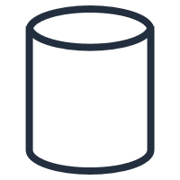
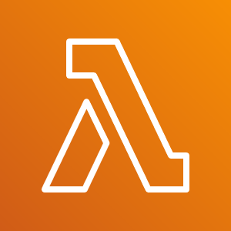



Serverless Computing
EVENT SOURCE
FUNCTION
SERVICES (ANYTHING)
Changes in data state
Node.js
Python
Java
C#
Go
PowerShell
Ruby
Requests to endpoints
Changes in resource state
Notes:
The model of compute is simple: you have an event coming from an AWS service or an invocation, a request coming from an endpoint or a change on a resource and your code gets executed.
This code can be built with virtually any kind of language. We, out of the box, support and manage these ones but you can build you custom runtime.
From this code, do what your business need! Connect to services, public endpoints, calculations, DBs, transformation. Basically, code.
15 mins execution limit
Event driven

Slide 12
Serverless: Lambda
Platform to run code without thinking about servers
Our definition
No servers to provision or manage
Scales with usage
Never pay for idle
High availability built in, fault tolerance made easier
Native integration with other AWS services
Benefits
Event-driven framework
Multiple invocation models
Opinionated

Slide 13


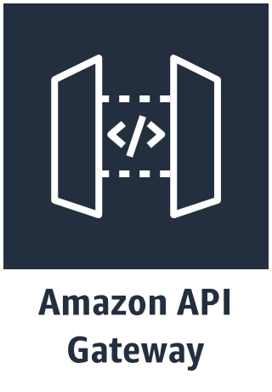
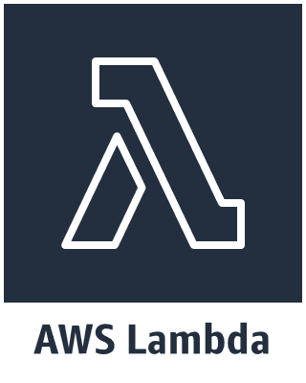
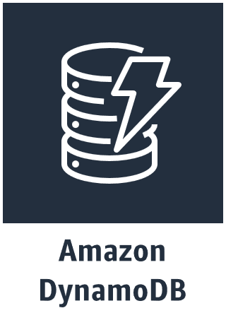
AWS serverless web architecture
AWS Cloud

Slide 14
Options for architecting your microservices
Containers
Serverless
Amazon ECS
AWS Lambda
Amazon EKS
AWS Fargate

Slide 15
Containers: ECS, EKS, Fargate
Platforms to run containerized applications on AWS
Easily run and scale applications to meet your needs
Native integration with other AWS services
Pairs well with CI/CD
Benefits
Portability
Control
Rich ecosystem

Slide 16




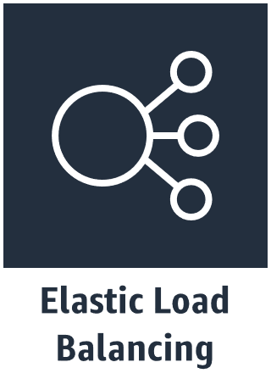


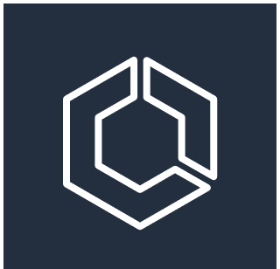


AWS container web architecture
VPC
Internet Gateway
Availability Zone A
Availability Zone B
Public Subnet
Public Subnet
NAT Gateway
NAT Gateway
Private Subnet
Private Subnet
ECS Cluster
Auto Scaling Group
Instances
Instances

Slide 17
Architectural considerations
Containers
Serverless
Custom code & services: Build your own environment
Numerous choices
Requires management and orchestration*
Standardized choices
Opinionated approach drives scalable platform
Security and scaling managed by AWS
Serverless and “containerless”
* - Fargate changes this model

Slide 18
Other considerations
Containers
Serverless
Wide array of power options
Power level managed by container, scoped by host
Fargate offers streamlined model
Multiple networking modes
Mature tooling
Easy power level selection
128MB to 3GB
Network and CPU assigned proportionally
Can overwhelm backends
Developing tooling
Organizational readiness?

Slide 19
So how do we decide?

Slide 20
Ideas on selecting … containers
When you need …
Lower startup latency
Support for long running compute jobs (> 15 minutes)
Predictable, high traffic usage
Persistence of data
When you want …
Complete control of compute environment
But not just for the sake of control

Slide 21
Ideas on selecting … serverless
When you need …
To trigger action on an event
Support for varying utilization
Ability to handle unknown demand
When you want to …
Quickly prove business value
Hand operational complexity (for example, patching, scaling) to AWS
Make fewer decisions

Slide 22
What if I can’t decide?
Load
balancer
Your
business
logic
Event
Function
Context

Slide 23
Decision Tree – well, almost!
Runtime environment compatible with AWS Lambda?
.NET Core, Go, Java, Python, or Node.js
Deployment Package size
<= 50MB
Desired Service runtime <= 15 minutes?
Unknown demand and below RPS breakeven
Inter-container communication* or storage-intensive?
Yes
Yes
Yes
Yes
No
AWS Lambda
No
No
No
No
Yes
Desire orchestration portability OR open source fan?
Yes
Amazon EKS
No
Are you comfortable managing your own infrastructure?
AWS Fargate
No
Yes
Amazon ECS

Slide 24
Architecting microservices

Slide 25



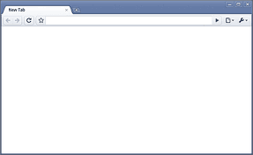
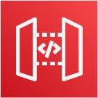







A basic serverless web application
AWS Cloud
Product microservice
Data store
Web application
Logo by Angular / CC BY 4.0
Amazon API Gateway
Amazon CloudFront
Amazon S3
Order microservice

Slide 26
Amazon API Gateway
Enables best practices for distributed systems
Throttling
Retry with exponential fallback
Fail fast
Support for public and private services

Slide 27
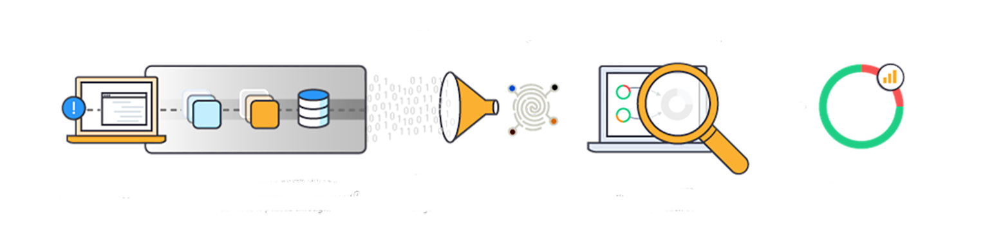
AWS X-Ray
Delivers insight into distributed applications
Uncover application issues
Improve application performance
Ready for ECS, Lambda, and more

Slide 28
Demo time!

Slide 29
1. Configuring an ALB to Invoke a Lambda Function 2. Packaging Libraries with Lambda Layers 3. Invoking Lambda Functions on a Schedule 4. Configuring a Lambda Function to Access an EFS File System 5. Running Trusted Code in Lambda Using AWS Signer 6. Packaging Lambda Code in a Container Image 7. Automating CSV Import into DynamoDB from S3 with Lambda 8. Reducing Lambda Startup Times with Provisioned Concurrency 9. Accessing VPC Resources with Lambda
Serverless

Slide 30
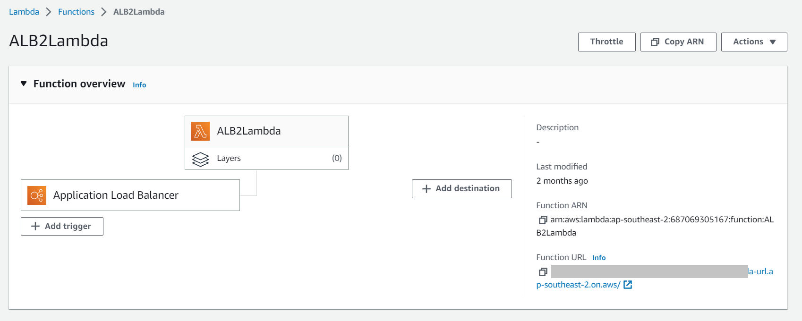
1. Configuring an ALB to Invoke a Lambda Function
Notes:
curl -i -X POST -H "Content-Type: application/json" -d '{"key1":"value1"}' http://invokeLambda-403835603.ap-southeast-2.elb.amazonaws.com/lambda/alb2lambda

Slide 31
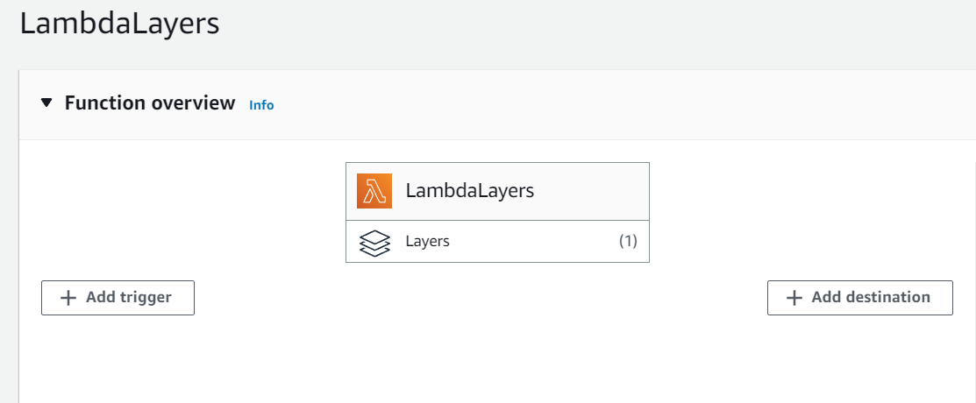
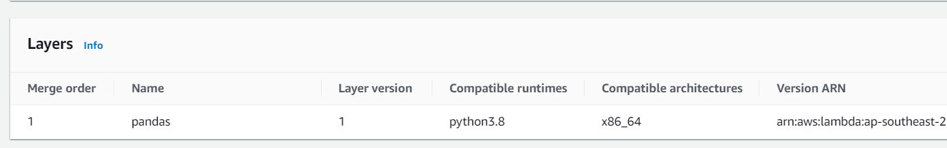
2. Packaging Libraries with Lambda Layers

Slide 32
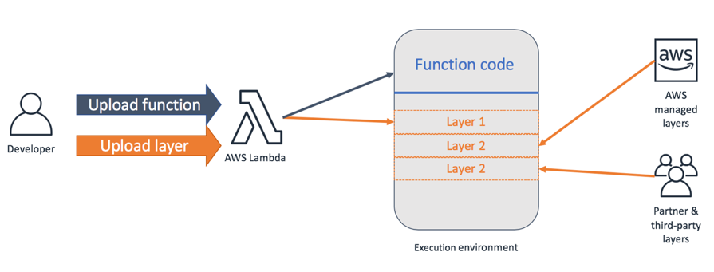

Slide 33
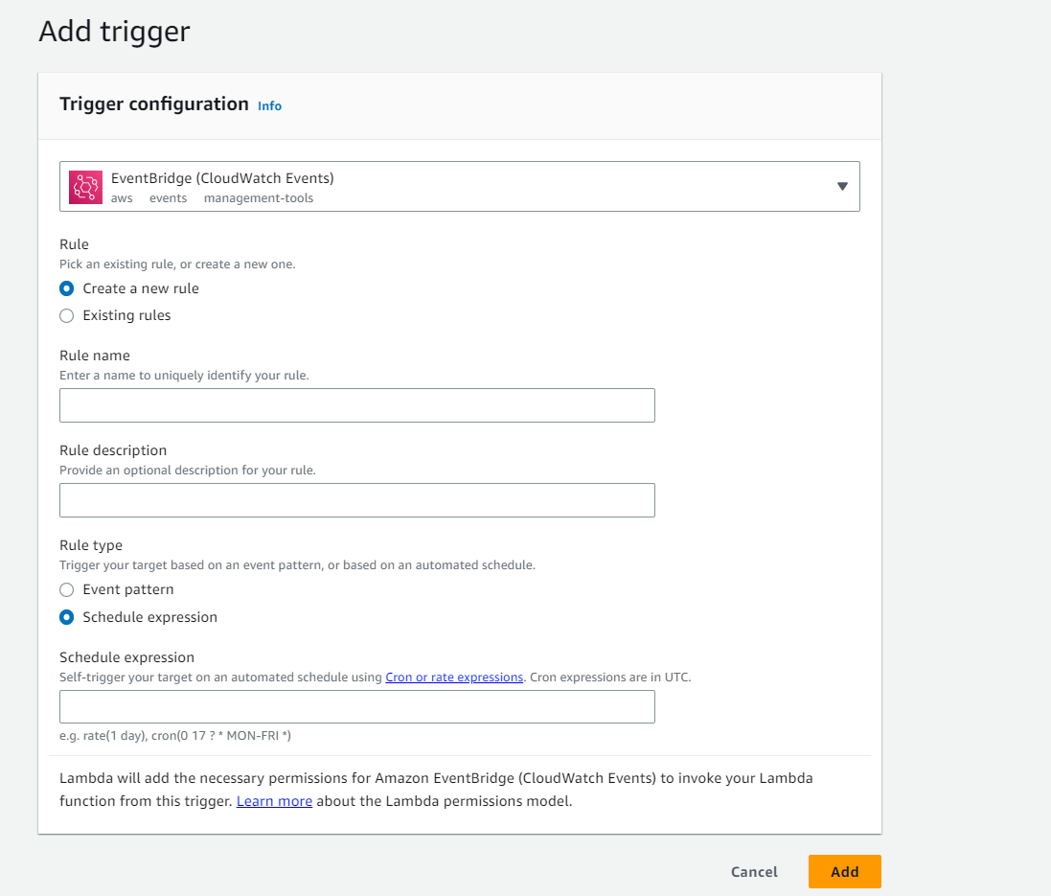
3. Invoking Lambda Functions on a Schedule

Slide 34
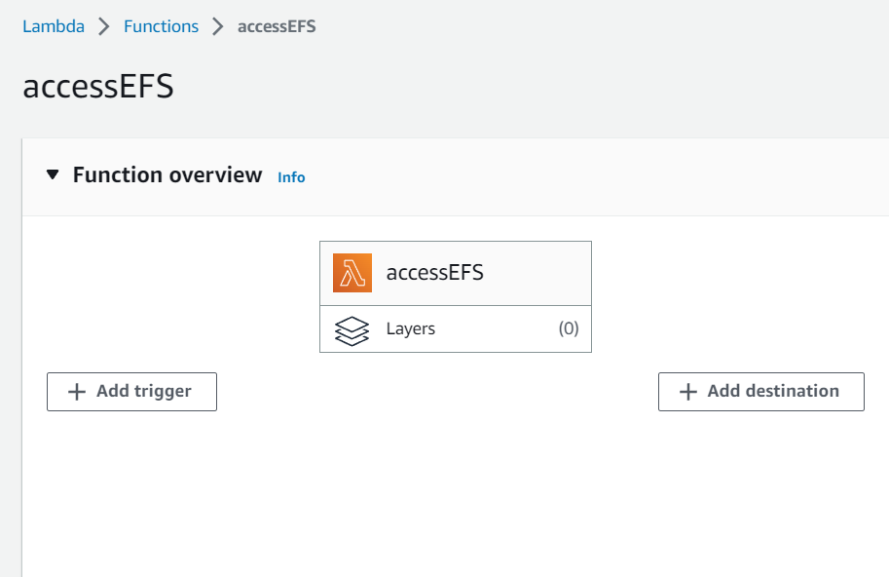
4. Configuring a Lambda Function to Access an EFS File System

Slide 35
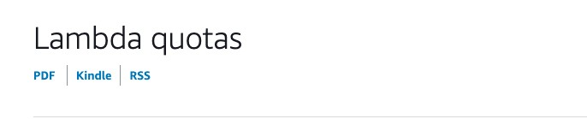
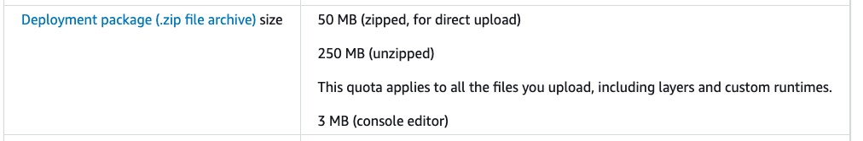
File system limitations
Ephemeral, for example, must be downloaded for each invocation
Model size + required code exceeds limit

Slide 36
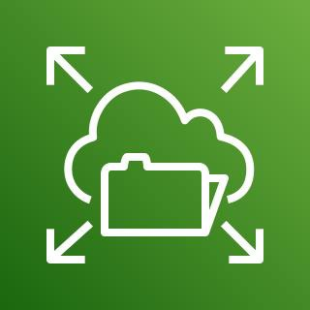
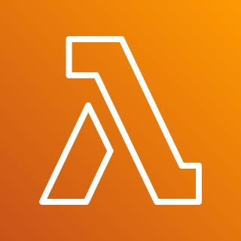
The solution
Amazon EFS
AWS Lambda

Slide 37

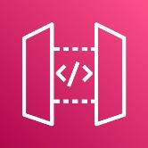


How it works
Users
Amazon API Gateway
API handler Lambda function
Amazon EFS file system
What is this?
Retrieve large model file
/detectObjects
Mounts file system when execution
environment is prepared
Minimal latency
If Lambda is warm, mount is already available
Scales to 25,000 concurrent connections

Slide 38
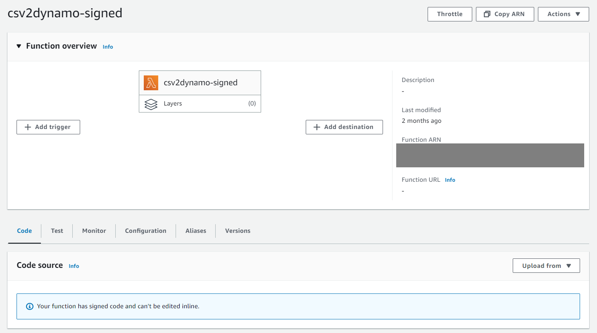
5. Running Trusted Code in Lambda Using AWS Signer

Slide 39
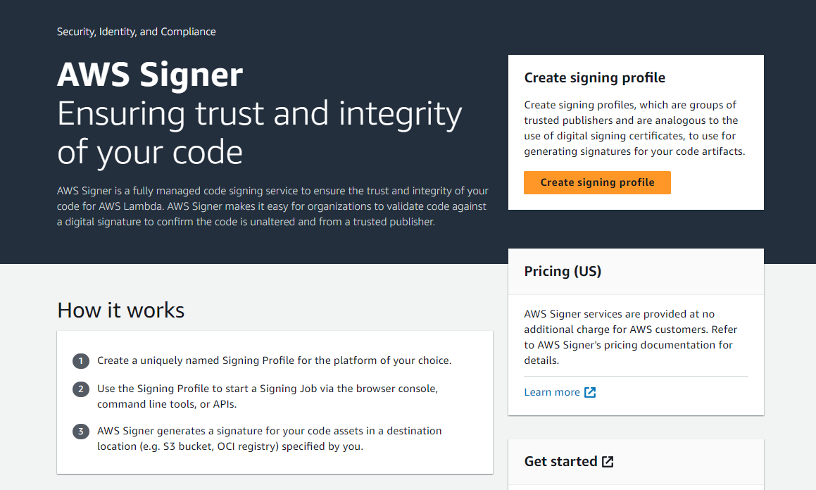
What is AWS Signer? - AWS Signer (amazon.com)

Slide 40
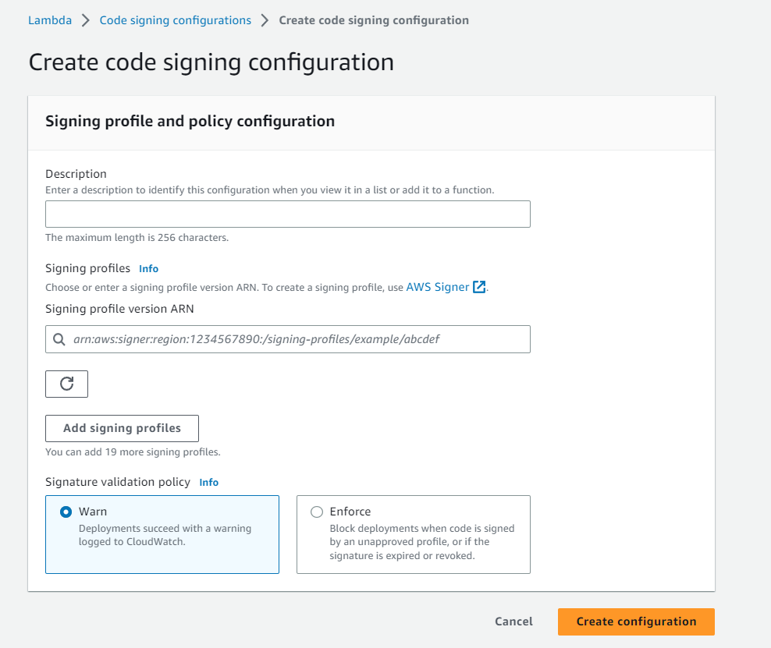
Code signing configurations
Create a configuration that you can attach to one or more functions to enable code signing. With code signing, you can ensure that the code has been signed by an approved source and has not been altered since signing, and that the code signature has not expired or been revoked.
Learn more
Configuring code signing for Lambda functions

Slide 41
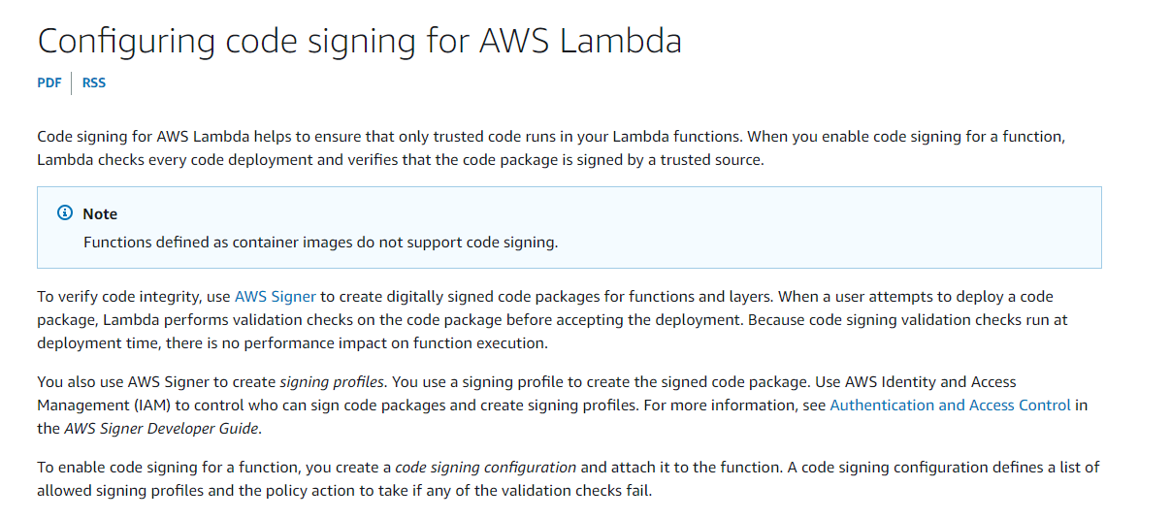
Configuring code signing for AWS Lambda - AWS Lambda (amazon.com)

Slide 42
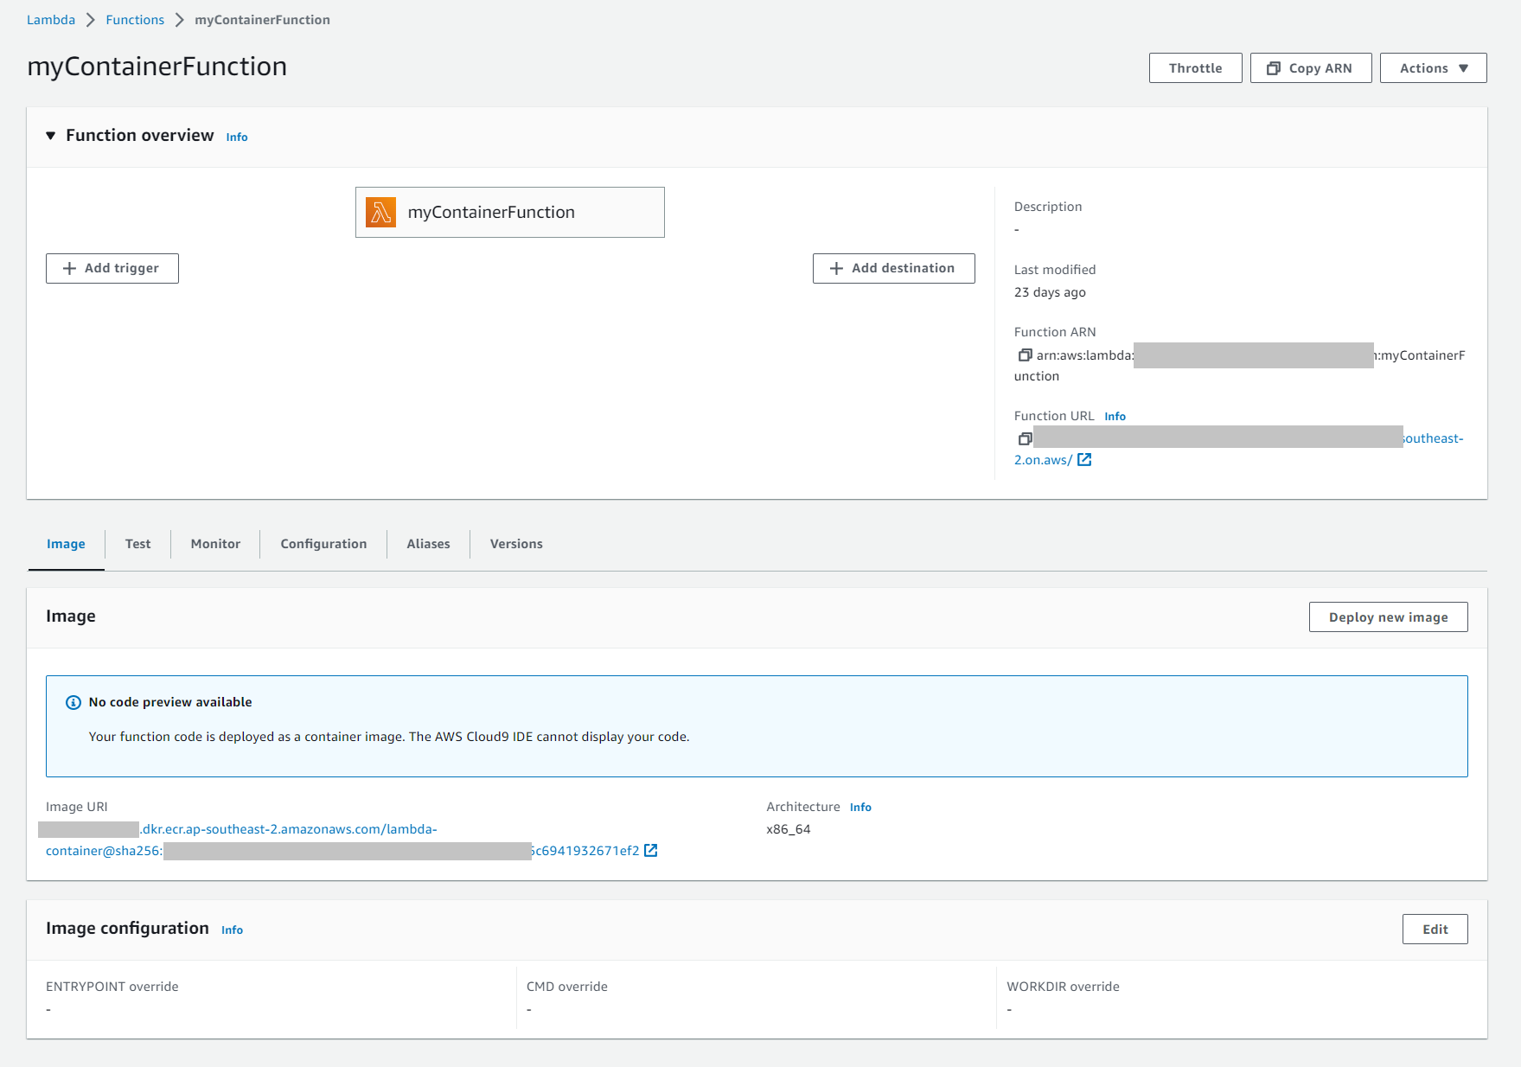
6. Packaging Lambda Code in a Container Image

Slide 43
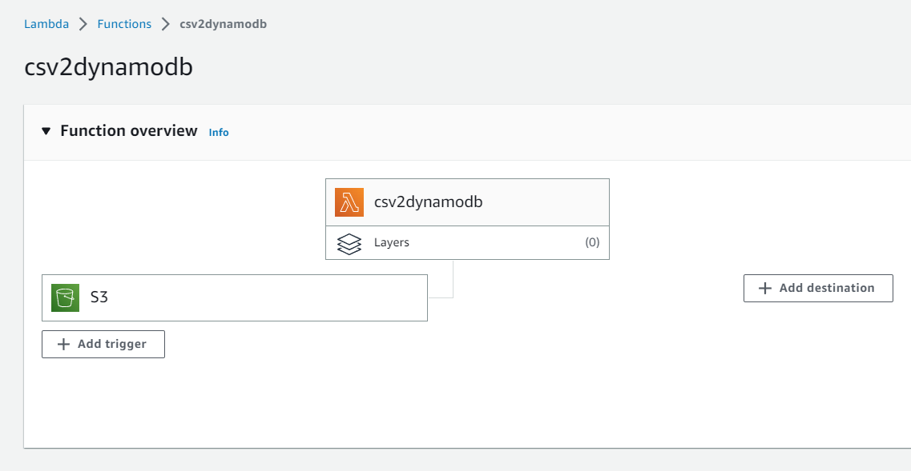
7. Automating CSV Import into DynamoDB from S3 with Lambda

Slide 44
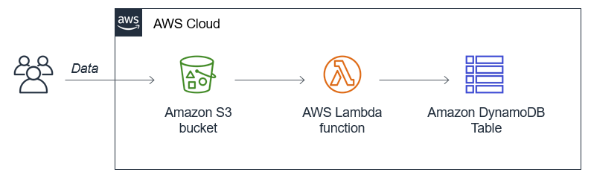
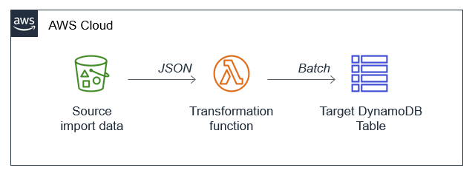
Creating a scalable serverless import process for Amazon DynamoDB

Slide 45
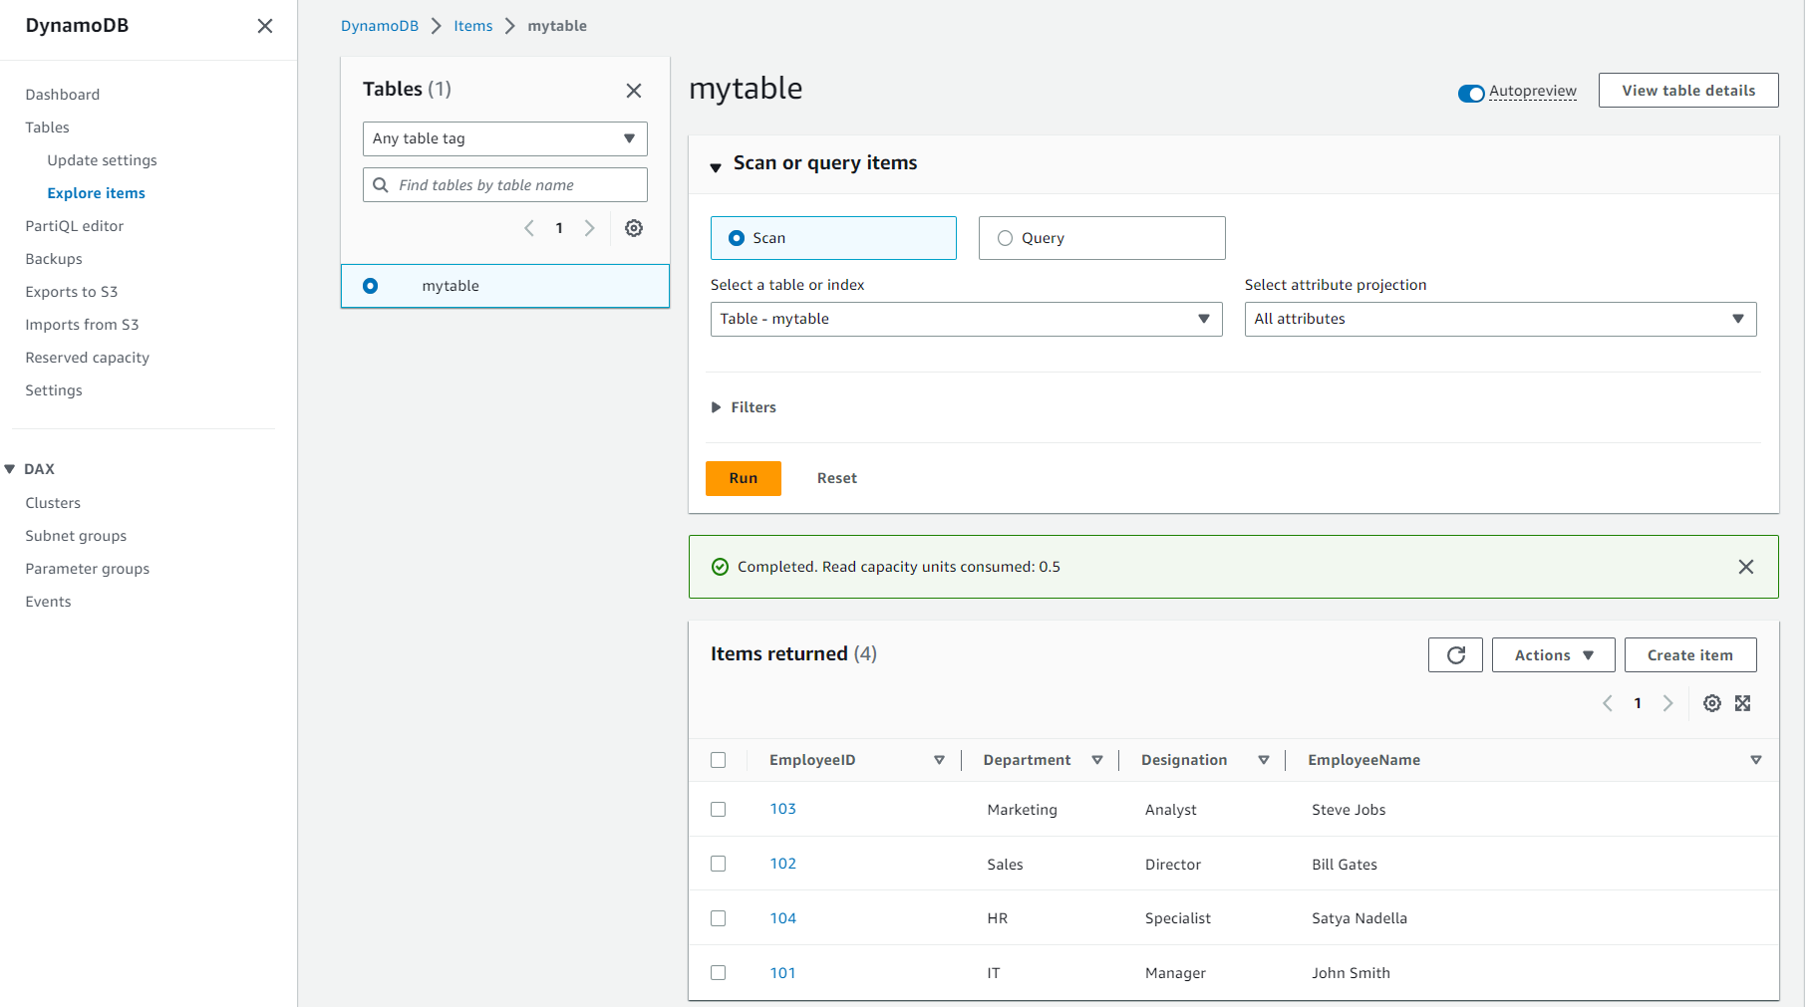

Slide 46
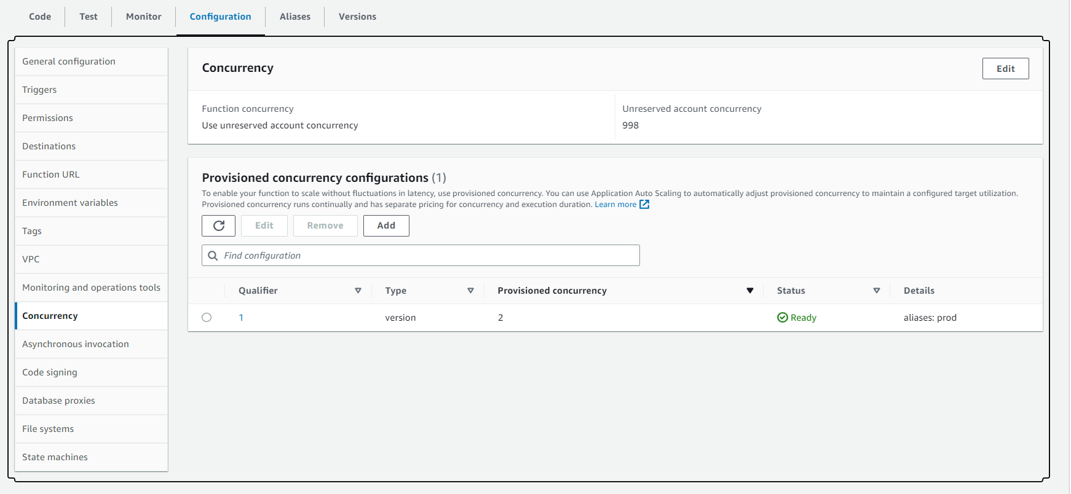
8. Reducing Lambda Startup Times with Provisioned Concurrency

Slide 47
Configuring reserved concurrency
In Lambda, concurrency is the number of requests your function can handle at the same time. There are two types of concurrency controls available:
Reserved concurrency – Reserved concurrency guarantees the maximum number of concurrent instances for the function. When a function has reserved concurrency, no other function can use that concurrency. There is no charge for configuring reserved concurrency for a function.
Provisioned concurrency – Provisioned concurrency initializes a requested number of execution environments so that they are prepared to respond immediately to your function's invocations. Note that configuring provisioned concurrency incurs charges to your AWS account.

Slide 48
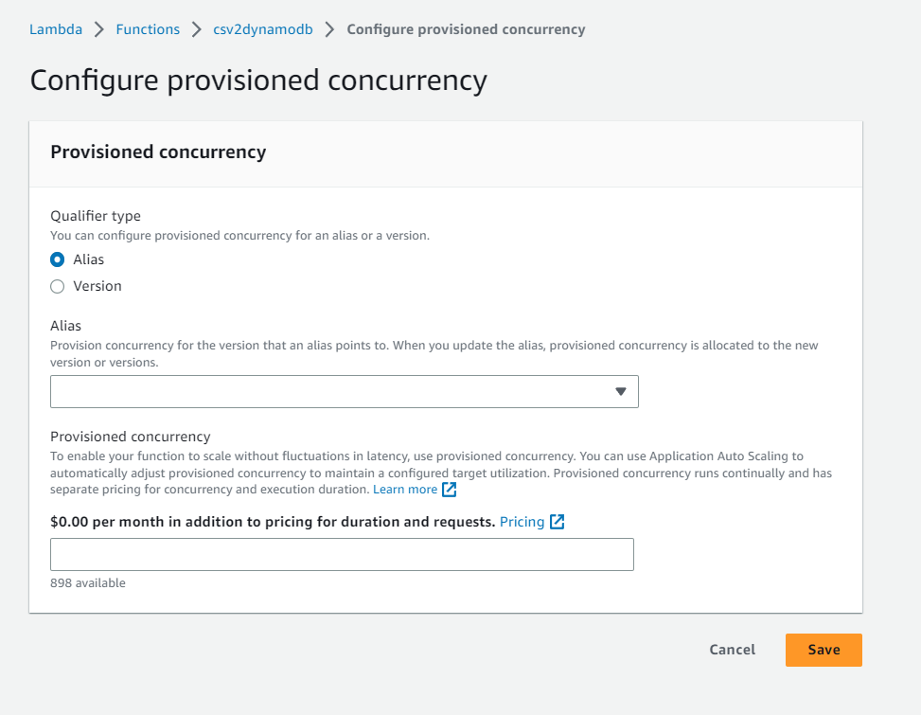
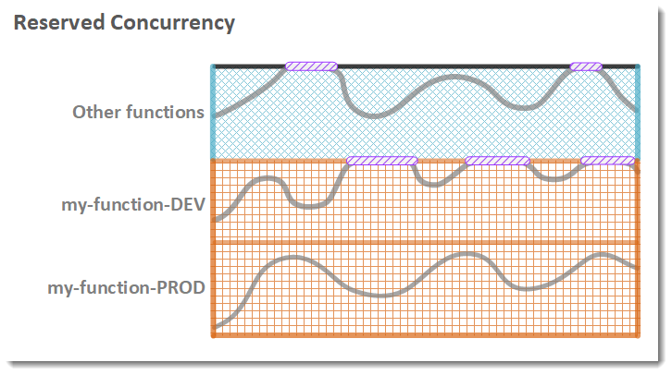

Slide 49
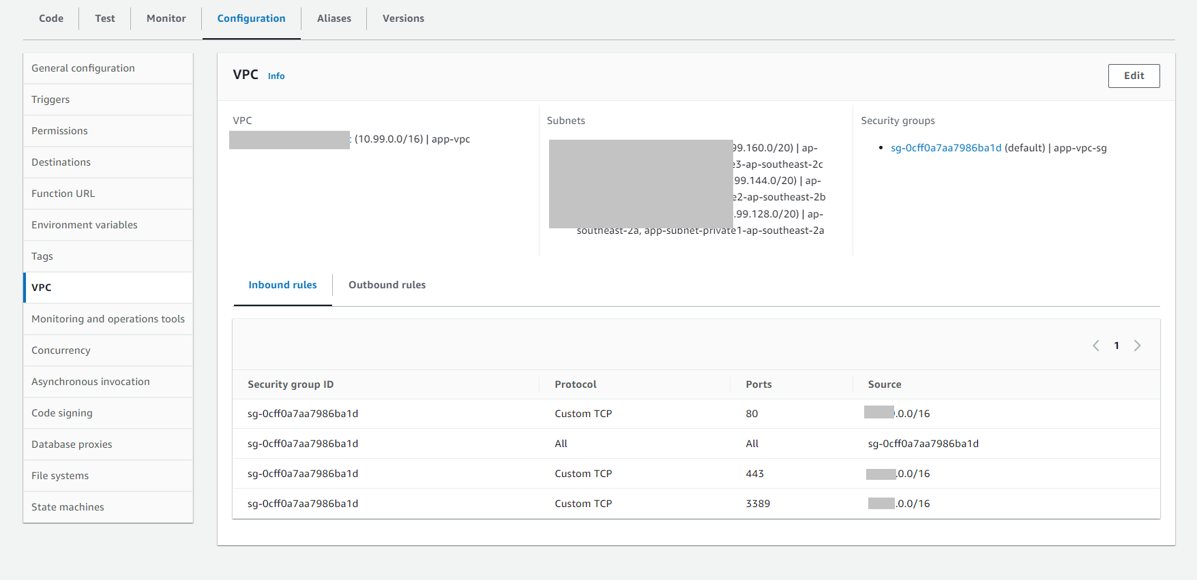
9. Accessing VPC Resources with Lambda

Slide 50
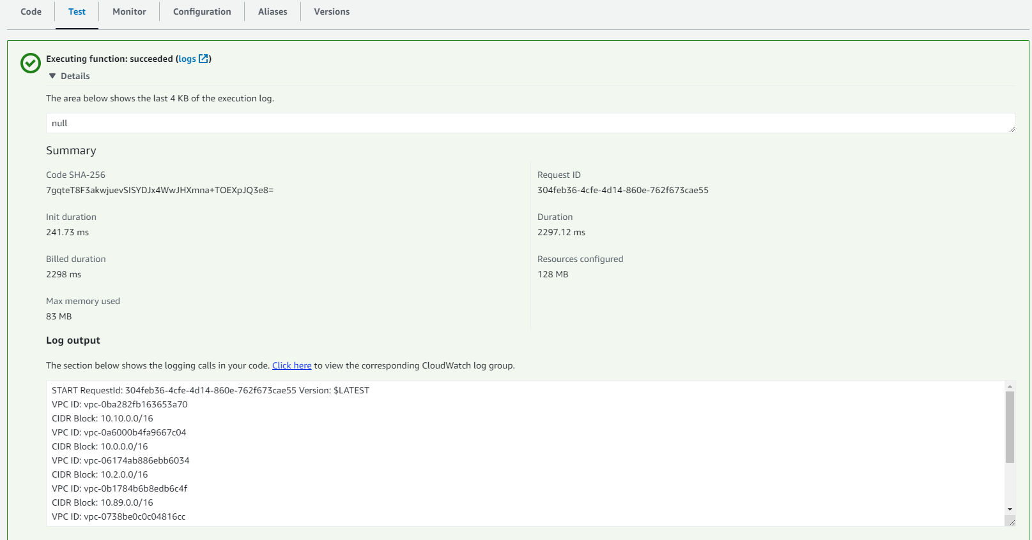

Slide 51
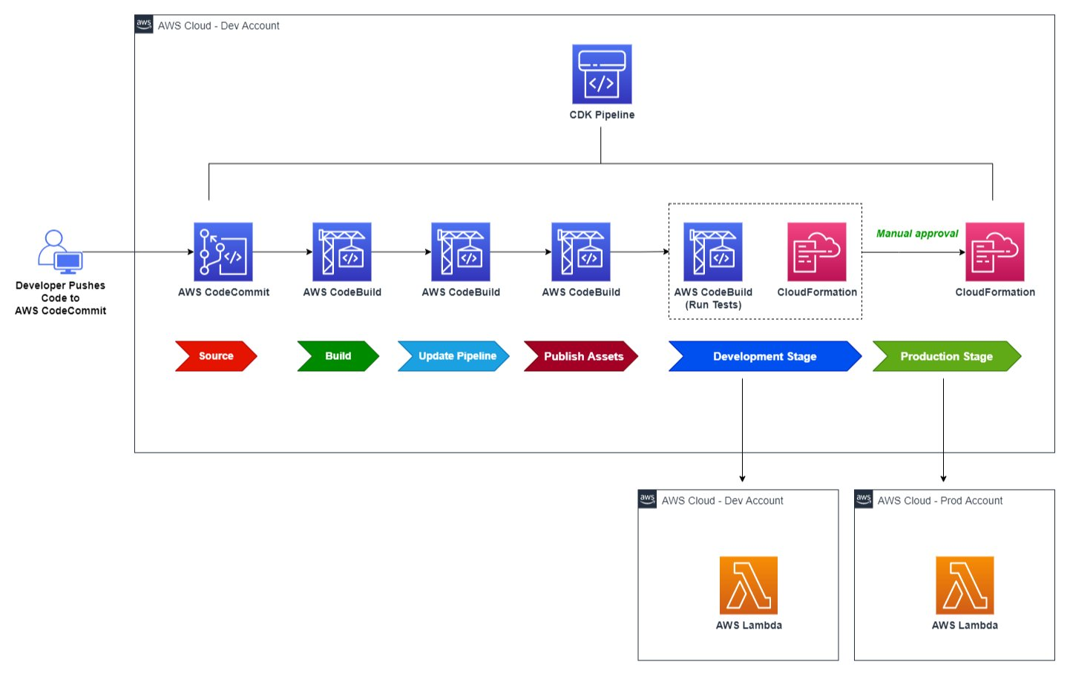

Slide 52
Q&A

Slide 53
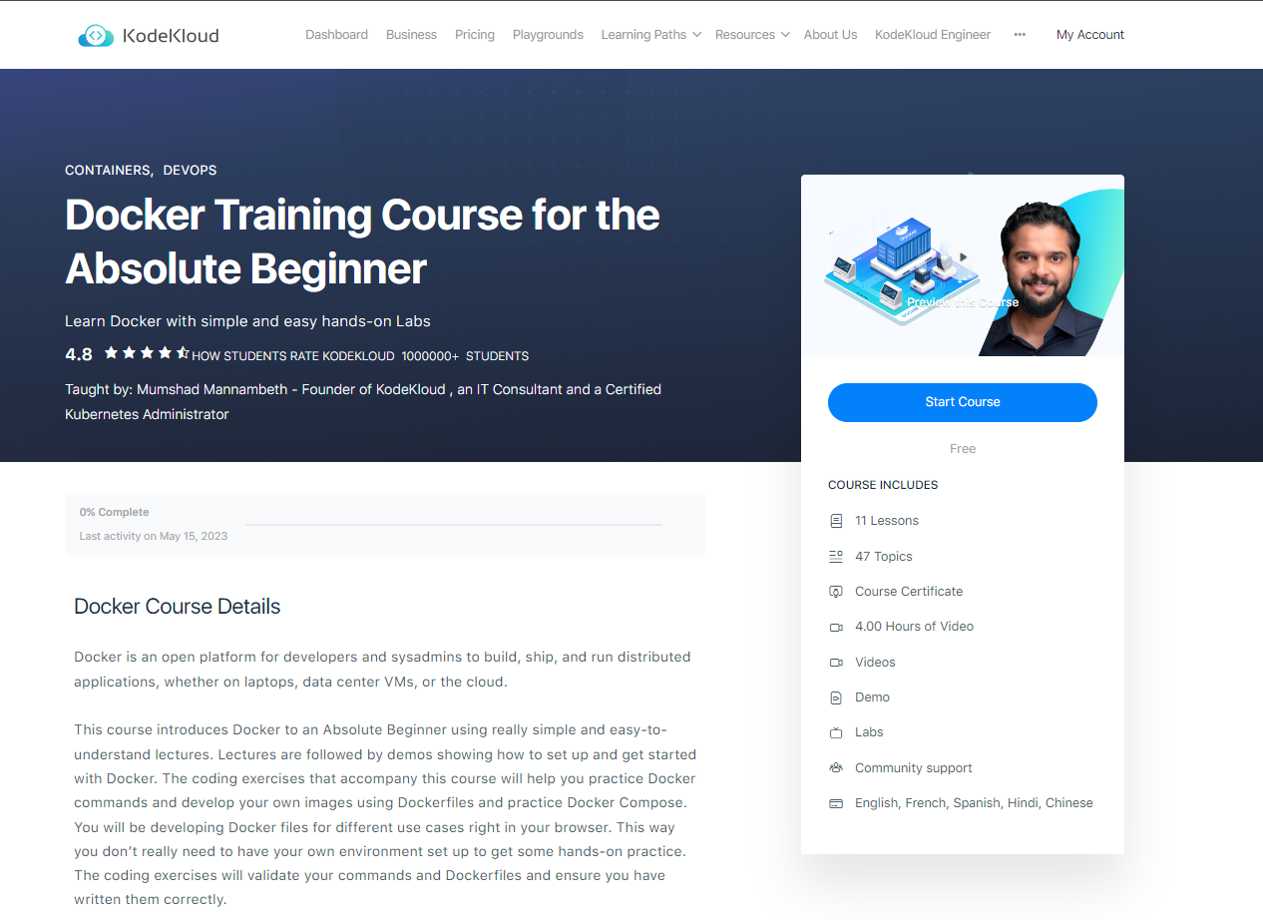
Online Docker Training Course for the Beginner | KodeKloud

Slide 54
Day 2 – Container Services on AWS ECS, ECR

Slide 55
Objective
Building, Tagging, and Pushing a Container Image to Amazon ECR
Scanning Images for Security Vulnerabilities on Push to Amazon ECR
Deploying a Container Using Amazon LightSail
Deploying Containers Using AWS Copilot
Updating Containers with Blue/Green Deployments
Autoscaling Container Workloads on Amazon ECS
Launching a Fargate Container Task in Response to an Event
Capturing Logs from Containers Running on Amazon ECS

Slide 56
Why use containers?

Slide 57

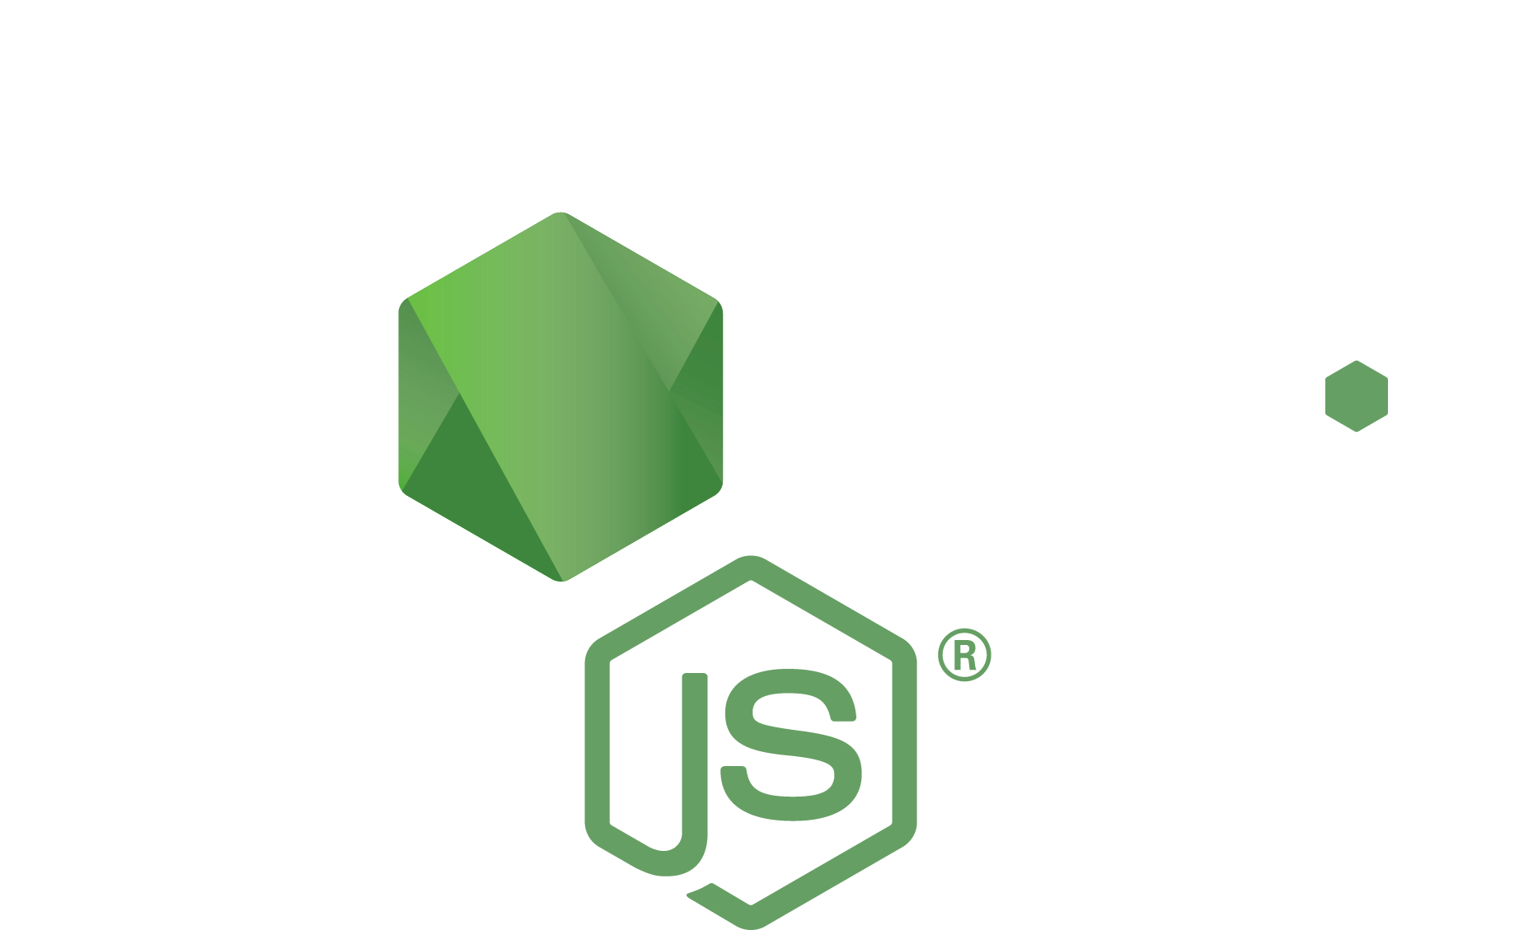


Applications aren’t just code, they have dependencies
Code packages
Operating system packages
Code
Runtime

Slide 58

Containers turn applications into one deployable artifact
Runtime
Code packages
Operating system packages
Code
Container image

Slide 59


Build
Gather the app and its dependencies. Create an immutable container image.
Push
Store the container image in a registry so it can be downloaded to compute
Run
Download image to compute, unpack it, and run it in an isolated environment

Slide 60

Containers turn dependencies into one deployable artifact that works anywhere
Service A
Code packages
Code
Container A
Your compute
Operating system packages
Node: 16.6.2

Slide 61

Containers turn dependencies into one deployable artifact that works anywhere
Service B
Code
PyPi packages
Container B
Your compute
Operating system packages
Python: 3.9.6

Slide 62

Containers solve cross platform build problems as well
docker build --platform linux/amd64
QEMU emulator (linux/amd64)
Laptop (arm64)
Container Build
Server (amd64)
Code
Operating system packages
Node: 16.6.2

Slide 63
Container manifests let you easily distribute and run software on multiple platform types
docker run nginx
Server (linux/amd64)
Container Manifest: linux/amd64
linux/arm64
Laptop (linux/arm64)

Slide 64
Amazon Elastic Container Service (ECS)

Slide 65
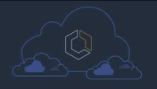

Slide 66
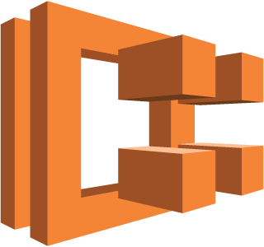
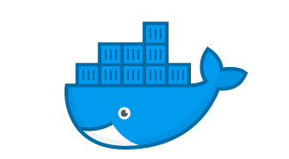
ECS Clusters Overview
ECS Clusters are logical grouping of EC2 instances
EC2 instances run the ECS agent (Docker container)
The ECS agents registers the instance to the ECS cluster
The EC2 instances run a special AMI, made specifically for ECS
ECS Agent
register
ECS Cluster
EC2 instance

Slide 67

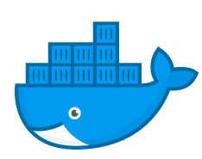
ECS T ask Definitions
www
Host port
8080
Tasks definitions are metadata in JSON form to tell ECS how to run a Docker Container
It contains crucial information around:
Image Name
Port Binding for Container and Host
Memory and CPU required
Environment variables
Networking information
IAM Role
Logging configuration (ex CloudWatch)
80
Container port
httpd
ECS Agent
EC2 instance

Slide 68
ECS Service
ECS Services help define how many tasks should run and how they should be run
They ensure that the number of tasks desired is running across our fleet of EC2 instances.
They can be linked to ELB / NLB / ALB if needed
Let’s make our first service!

Slide 69
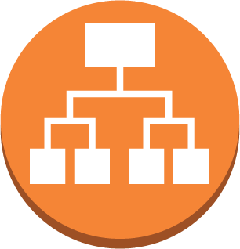
ECS Service with Load Balancer
32698
32667
80
80
httpd
www
httpd
32657
32713
80
80
httpd
httpd
Application Load Balancer
ECS Agent
ECS Agent
With dynamic port forwarding
EC2 instance
EC2 instance

Slide 70

ECR
NOT FOR DISTRIBUTION © Stephane Maarek www.datacumulus.com
So far we’ve been using Docker images from Docker Hub (public)
ECR is a private Docker image repository
Access is controlled through IAM (permission errors => policy)
You need to run some commands to push pull:
$(aws ecr get-login --no-include-email --region eu-west-1)
docker push 1234567890.dkr.ecr.eu-west-1.amazonaws.com/demo:latest
docker pull 1234567890.dkr.ecr.eu-west-1.amazonaws.com/demo:latest
© Stephane Maarek

Slide 71
Why use AWS Fargate?

Slide 72


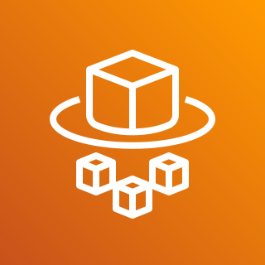

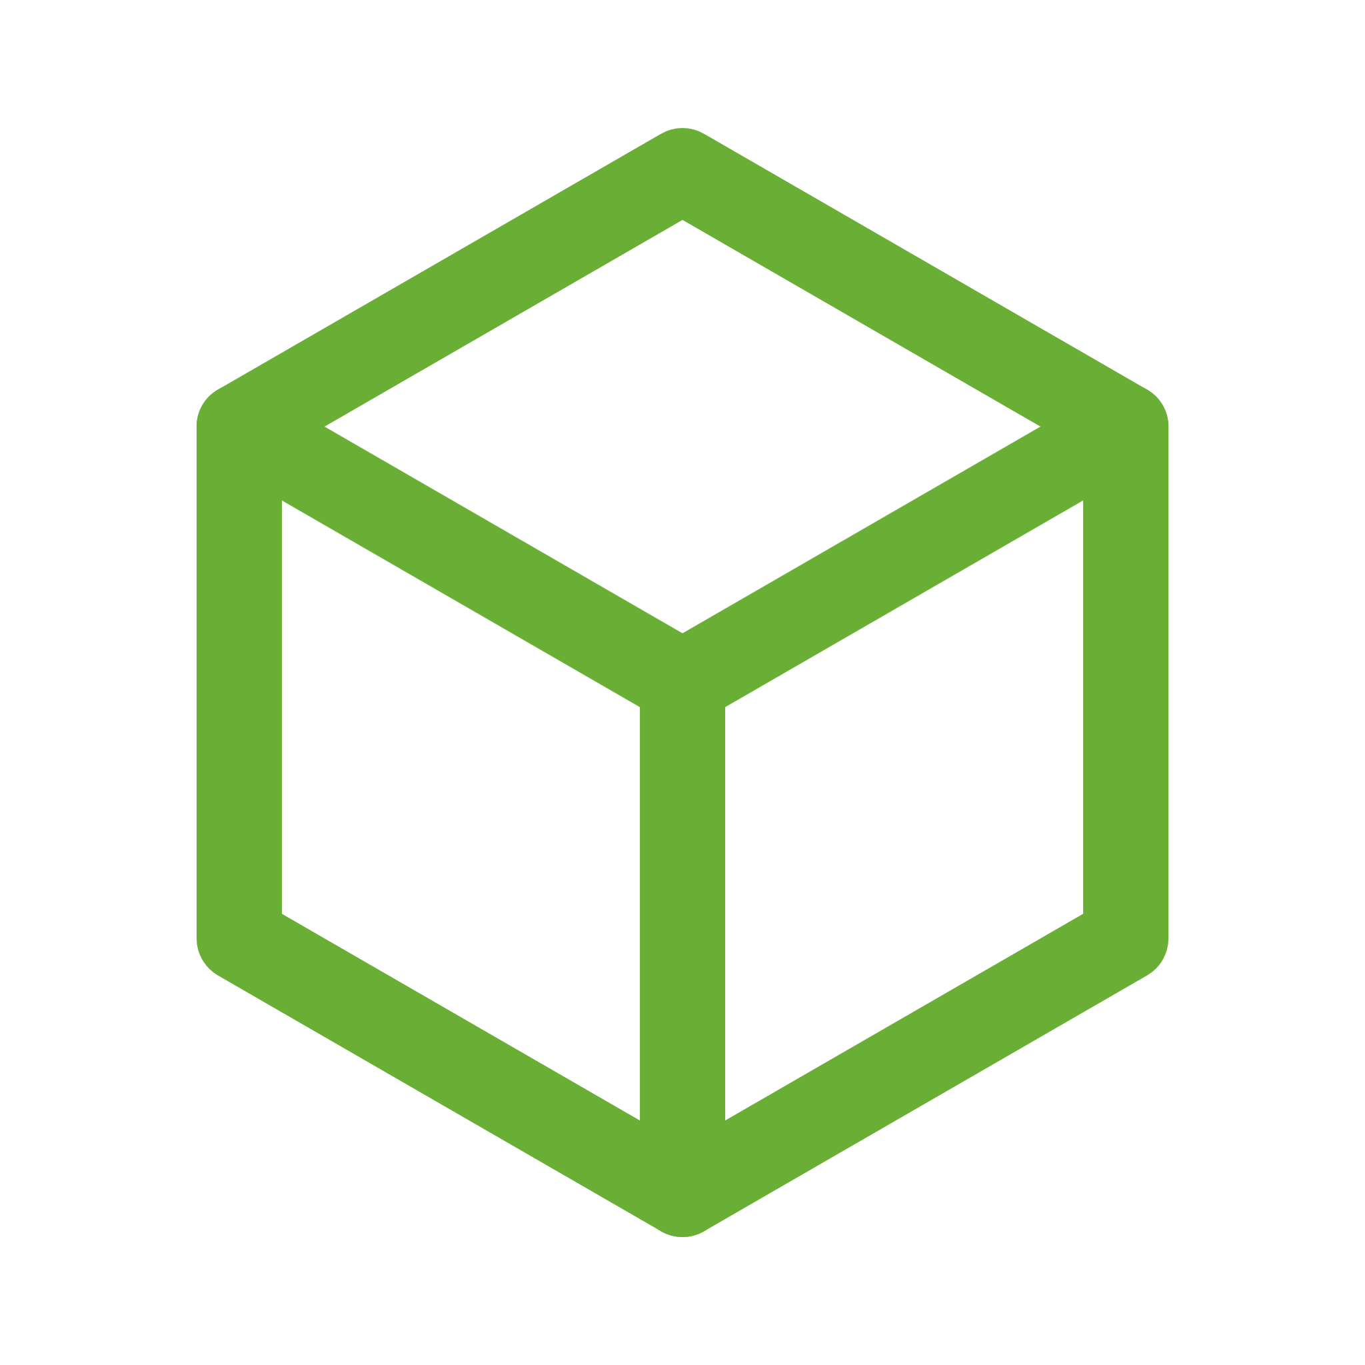
AWS Fargate helps you run container images directly
1 x vCPU
2 GB memory
Amazon Elastic Container Service
AWS Fargate
Here is my container image. It needs 1 CPU and 2 GB of memory to run. I want to launch 4 copies of it as a service.

Slide 73


AWS Fargate launches each container in it’s own isolated micro VM that is right sized for that container alone.
Service C
Service B
Service B
Service C
AWS Fargate
Service B
Service A
Service A
No more worrying about EC2 instances

Slide 74





Amazon Elastic Container Service and AWS Fargate automate resource attachments to application containers
Logs &
Metrics
Amazon CloudWatch
Secrets
Fargate Task
AWS Secrets Manager
Role
AWS Identity and Access Management (IAM)
Traffic
Elastic Load Balancing
Durable
Storage
Amazon Elastic File System

Slide 75
Container
Building, Tagging, and Pushing a Container Image to Amazon ECR
Scanning Images for Security Vulnerabilities on Push to Amazon ECR
Deploying a Container Using Amazon LightSail
Deploying Containers Using AWS Copilot
Updating Containers with Blue/Green Deployments
Autoscaling Container Workloads on Amazon ECS
Launching a Fargate Container Task in Response to an Event
Capturing Logs from Containers Running on Amazon ECS

Slide 76
AWS Copilot

Slide 77
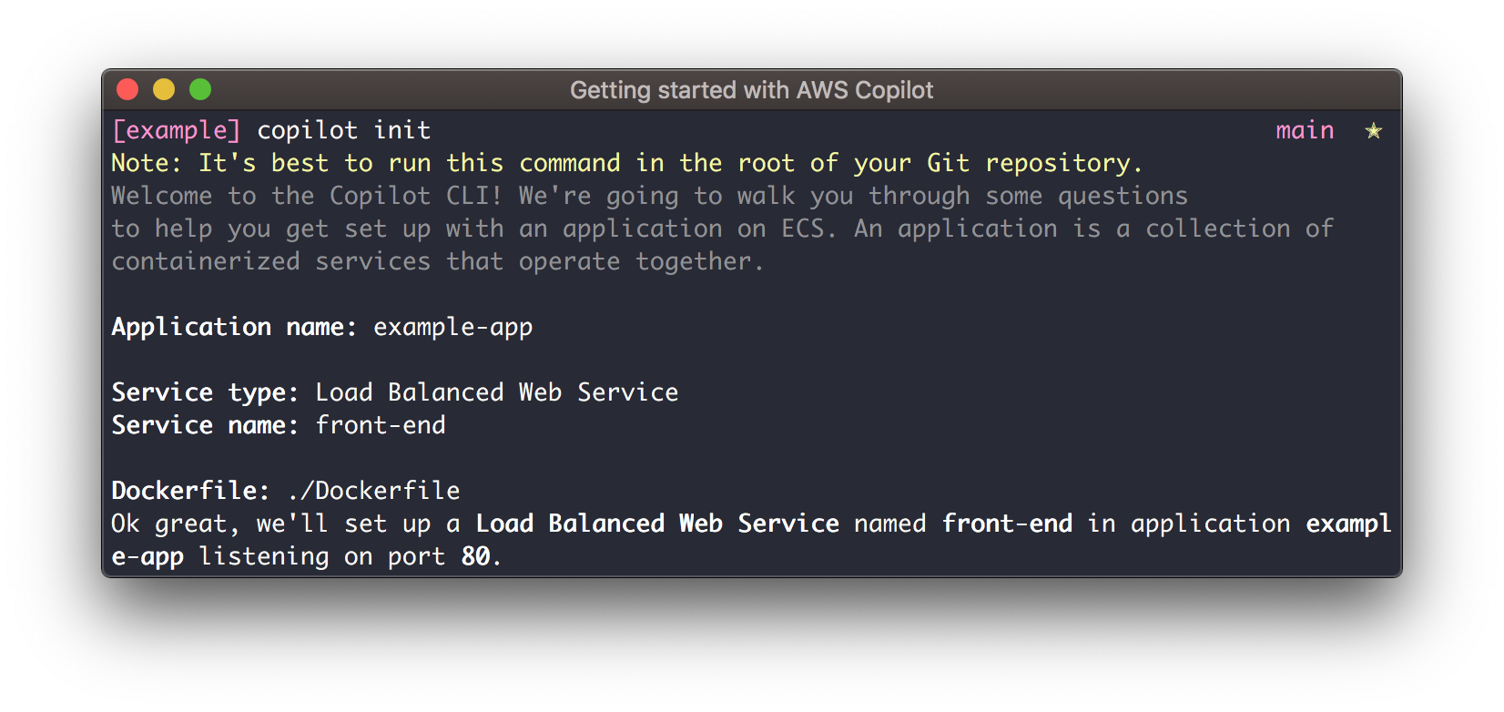
AWS Copilot is the command line tool for AWS Fargate
Environment
Copilot asks questions about what type of app you are building, then constructs an environment for it

Slide 78
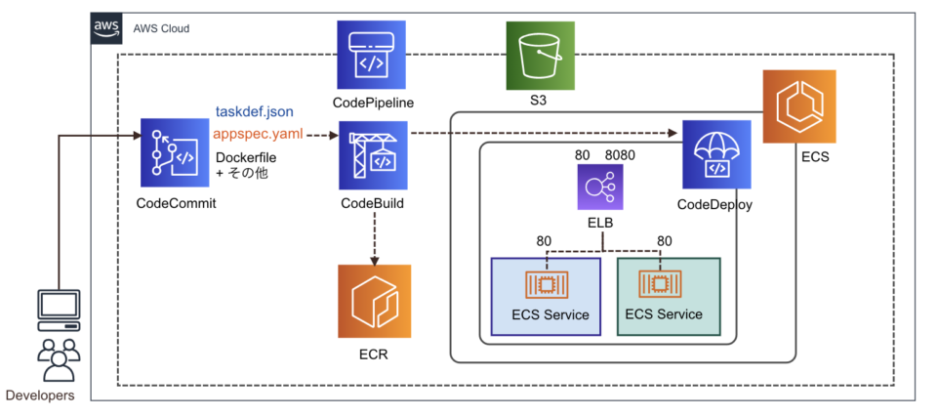
ECS Blue / Green Deployment

Slide 79
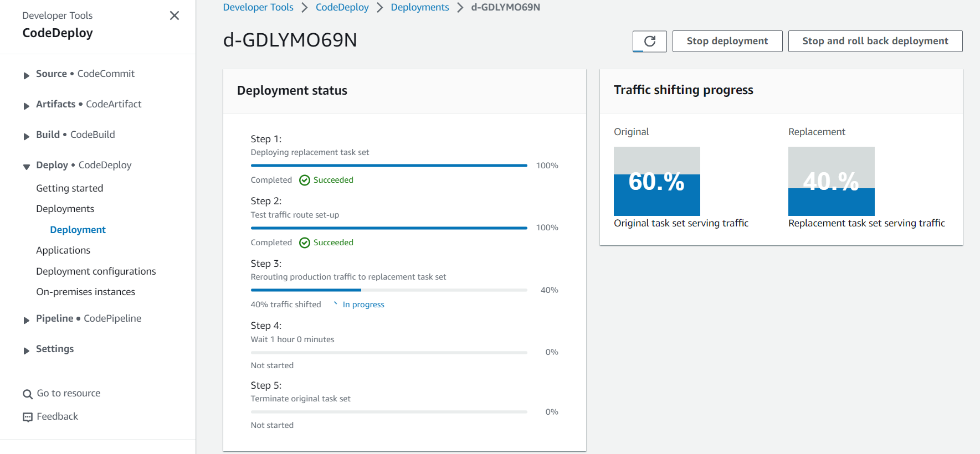

Slide 80


Slide 81


Slide 82


Slide 83


Slide 84
SDLC Automation (Systems development life cycle)

Slide 85
Continuous Integration
Developers push the code to a code
repository often (GitHub / CodeCommit / Bitbucket / etc…)
A testing / build server checks the code as
soon as it’s pushed (CodeBuild / Jenkins CI
/ etc…)
The developer gets feedback about the tests and checks that have passed / failed
Tell developer results of build
Push code often
Build Server
Code Repository
Find bugs early, fix bugs
Deliver faster as the code is tested
Deploy often
Happier developers, as they’re unblocked
Get code build & test

Slide 86
Continuous Delivery
Ensure that the software can be released reliably whenever needed.
Ensures deployments happen often and are quick
Shift away from “one release every 3 months” to ”5 releases a day”
That usually means automated deployment
CodeDeploy
Jenkins CD
Push code often
Code Repository
Get code build & test
Build Server
Deploy every passing build
Deployment Server
Spinnaker
Etc…
Application Server v1
Application Server v1
Application Server v1
Application Server v2
Application Server v2
Application Server v2

Slide 87
Technology Stack for CICD
Code
Build
Test
Deploy
Provision
AWS
CodeCommit
AWS CodeBuild
AWS Elastic Beanstalk
AWS CodeDeploy | User Managed EC2 Instances Fleet (CloudFormation)
GitHub Or 3rd party
code repository
Jenkins CI
Or 3rd party CI servers
Orchestrate: AWS CodePipeline

Slide 88

CodeCommit
Version control is the ability to understand the various changes that happened to the code over time (and possibly roll back).
All these are enabled by using a version control system such as Git
A Git repository can live on one’s machine, but it usually lives on a central online repository
Benefits are:
Collaborate with other developers
Make sure the code is backed-up somewhere
Make sure it’s fully viewable and auditable

Slide 89
CodeCommit
Git repositories can be expensive.
The industry includes:
GitHub: free public repositories, paid private ones
BitBucket
Etc...
And AWS CodeCommit:
private Git repositories
No size limit on repositories (scale seamlessly)
Fully managed, highly available
Push code often
Code Repository
Code only in AWS Cloud account => increased security and compliance
Secure (encrypted, access control, etc…)
Integrated with Jenkins / CodeBuild / other CI tools

Slide 90

CodeBuild Overview
Fully managed build service
Alternative to other build tools such as Jenkins
Continuous scaling (no servers to manage or provision – no build queue)
Pay for usage: the time it takes to complete the builds
Leverages Docker under the hood for reproducible builds
Possibility to extend capabilities leveraging our own base Docker images
Secure: Integration with KMS for encryption of build artifacts, IAM for build permissions, and VPC for network security, CloudTrail for API calls logging

Slide 91
CodeBuild Overview
Source Code from GitHub / CodeCommit / CodePipeline / S3…
Build instructions can be defined in code (buildspec.yml file)
Output logs to Amazon S3 & AWS CloudWatch Logs
Metrics to monitor CodeBuild statistics
Use CloudWatch Events to detect failed builds and trigger notifications
Use CloudWatch Alarms to notify if you need “thresholds” for failures
CloudWatch Events / AWS Lambda as a Glue
SNS notifications

Slide 92
AWS CodeDeploy
We want to deploy our application automatically to many EC2 instances
There are several ways to handle deployments using open source tools (Ansible,Terraform, Chef, Puppet, etc…)
We can use the managed Service AWS CodeDeploy
v1
v2
v1
v2
v1
v2
v1
v2

Slide 93



AWS CodeDeploy – Steps to make it work
Each EC2 Machine (or On Premise machine) must be running the CodeDeploy Agent
The agent is continuously polling AWS CodeDeploy for work to do
CodeDeploy sends appspec.yml
file.
Application is pulled from GitHub or S3
EC2 will run the deployment instructions
CodeDeploy Agent will report of
success / failure of deployment on the instance
GitHub
Source code
+
appspec.yml file
Amazon S3
1. push
4. Download code
+ appspec.yml file
2. Trigger deployment
3. poll
EC2 instances + agent

Slide 94
AWS CodeDeploy
EC2 instances are grouped by deployment group (dev / test / prod)
Lots of flexibility to define any kind of deployments
CodeDeploy can be chained into CodePipeline and use artifacts from there
CodeDeploy can re-use existing setup tools, works with any application, auto scaling integration
Note: Blue / Green only works with EC2 instances (not on premise)
Support for AWS Lambda deployments, EC2
CodeDeploy does not provision resources

Slide 95

CodePipeline
Continuous delivery
Visual workflow
Source: GitHub / CodeCommit / Amazon S3
Build: CodeBuild / Jenkins / etc…
Load Testing: 3rd party tools
Deploy: AWS CodeDeploy / Beanstalk / CloudFormation / ECS…
Made of stages:
Each stage can have sequential actions and / or parallel actions
Stages examples: Build / Test / Deploy / Load Test / etc…
Manual approval can be defined at any stage

Slide 96
Technology Stack for CICD
Code
Build
Test
Deploy
Provision
AWS
CodeCommit
AWS CodeBuild
AWS Elastic Beanstalk
AWS CodeDeploy | User Managed EC2 Instances Fleet (CloudFormation)
GitHub Or 3rd party
code repository
Jenkins CI
Or 3rd party CI servers
Orchestrate: AWS CodePipeline

Slide 97

AWS CodePipeline Artifacts
Each pipeline stage can create ”artifacts”
Artifacts are passed stored in Amazon S3 and passed on to the next stage
Source (CodeCommit)
Build (CodeBuild)
Deploy (CodeDeploy)
trigger
deploy
Output artifacts
Input artifacts
Output artifacts
Input artifacts
Amazon S3 bucket

Slide 98
Q&A

Slide 99
Thank you!

